Slide 1
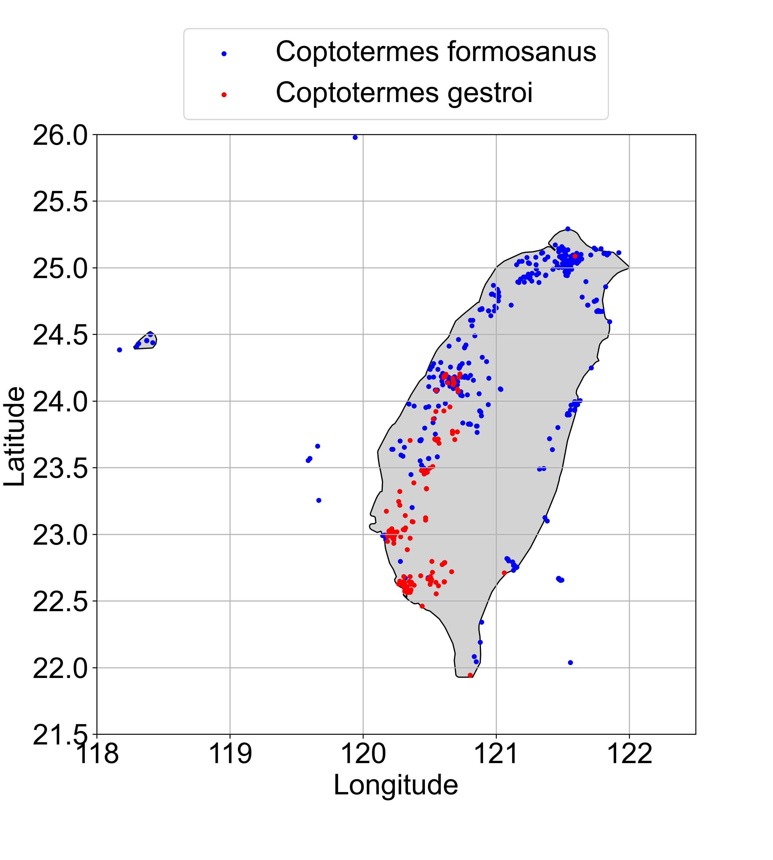
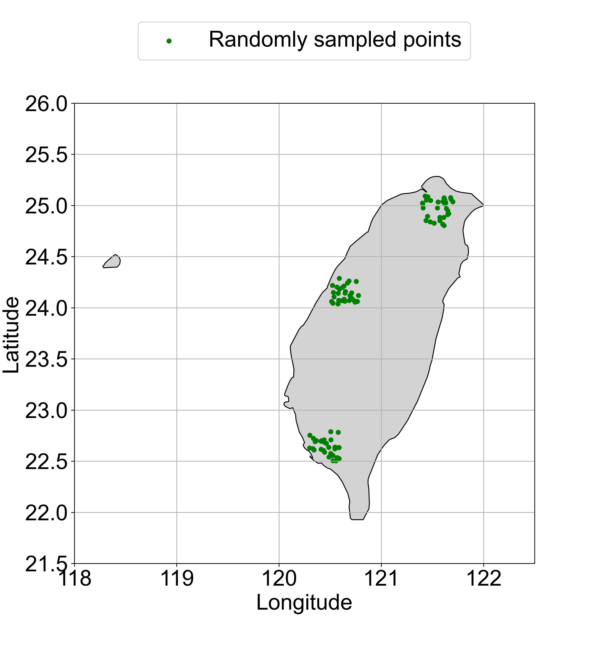
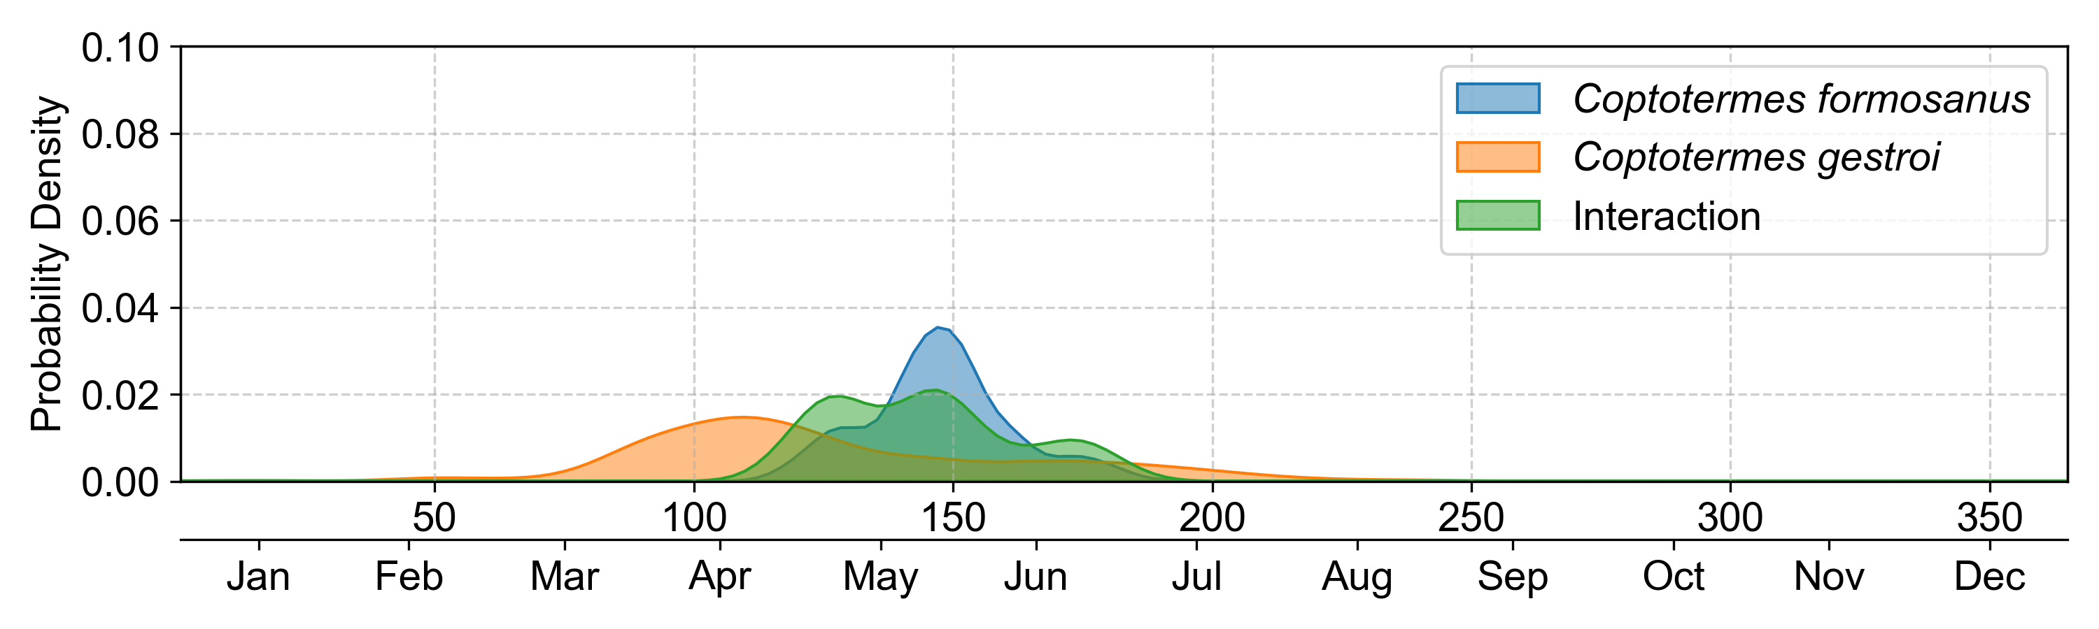
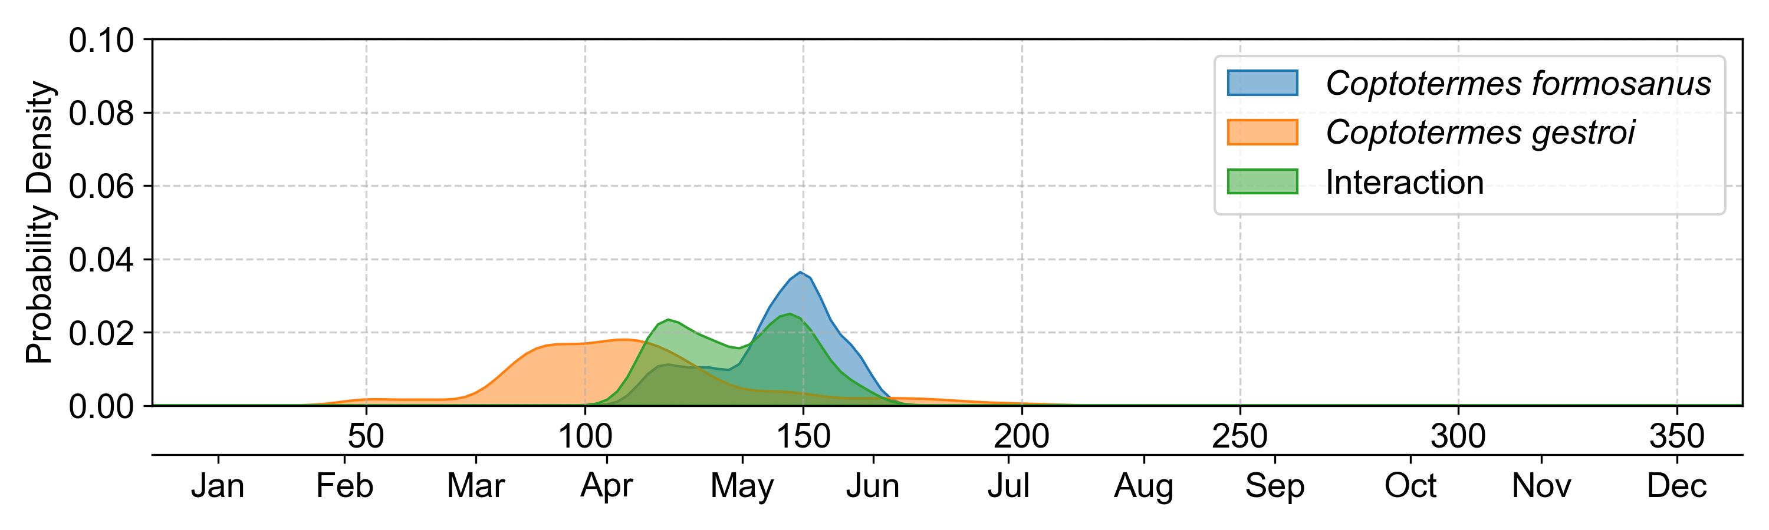
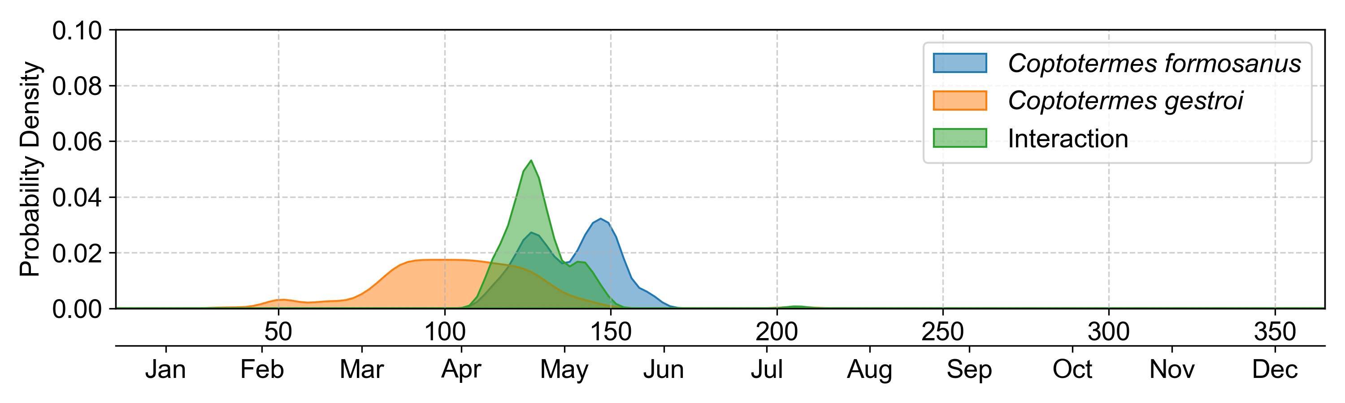
A
B
Northern
Middle-western
Southern
C
Northern area
Accumulated interaction score = 108.0236
D
Middle-western area
Accumulated interaction score = 145.7822
E
Southern area
Accumulated interaction score = 276.9455

